Slide 1

Downloading Images from Google and Making My Own DB

Slide 2

Reference
youtube-jocoding’s Youtube and Code
Youtube on Dataset Flower
Youtube on os Module Functions used in Dataset Flower
Youtube
Code

Slide 3
Downloading Images from Google

Slide 4
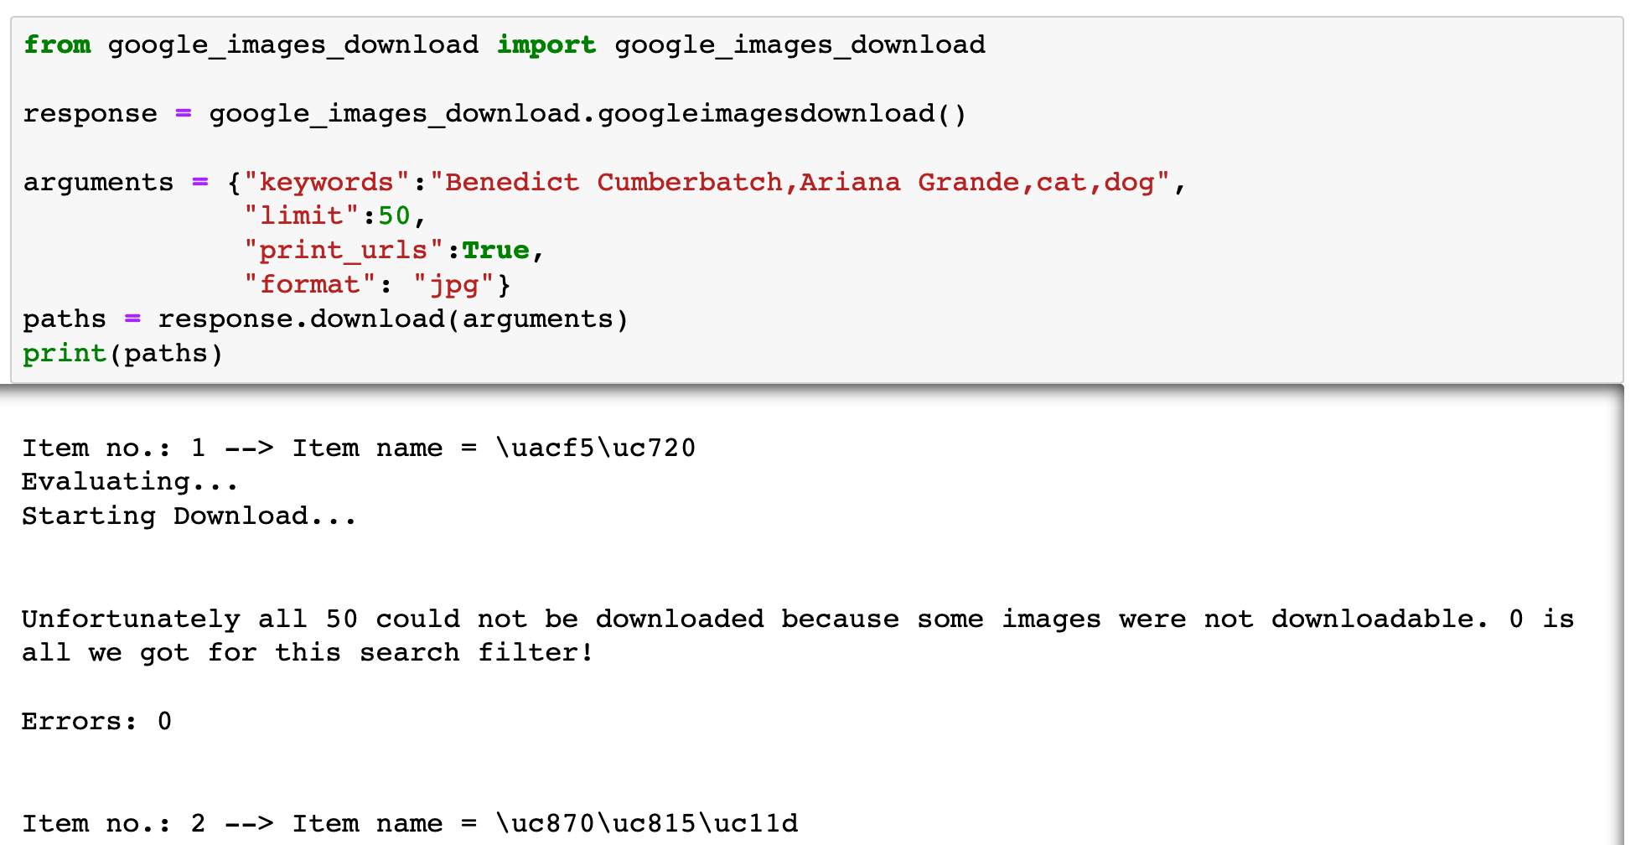

Slide 5
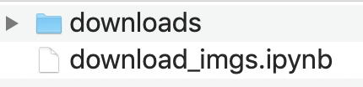

Slide 6
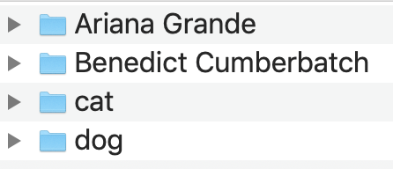

Slide 7
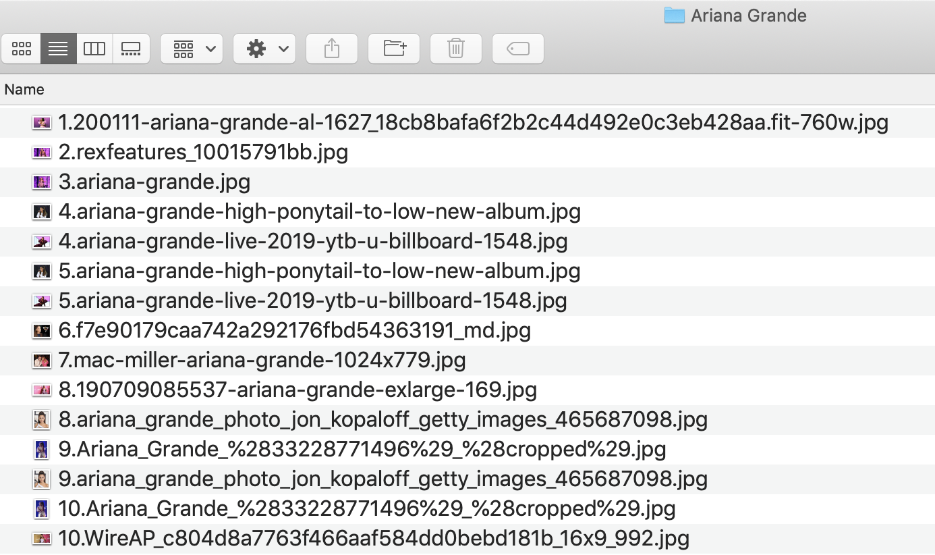

Slide 8
Create downloads _classes list

Slide 9
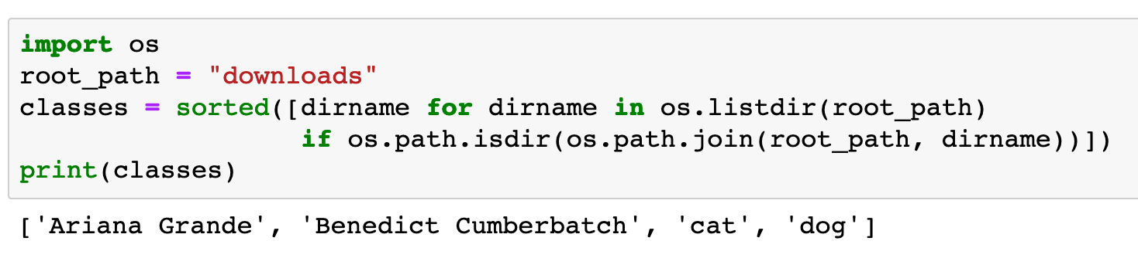


Slide 10
Create image_paths dict

Slide 11
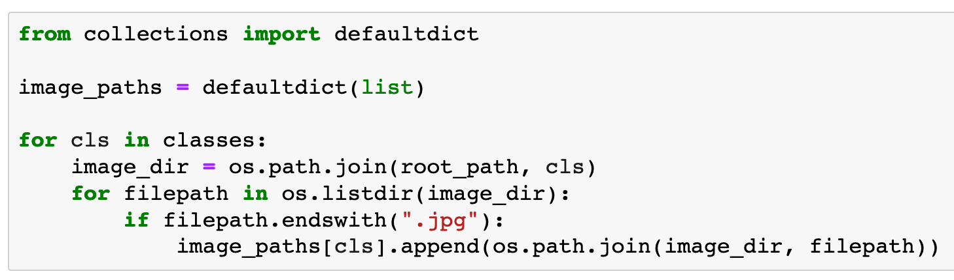

Slide 12
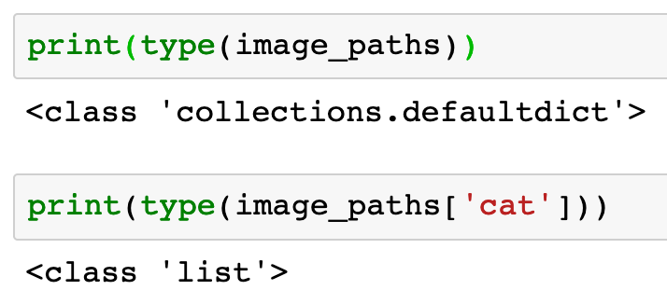


Slide 14
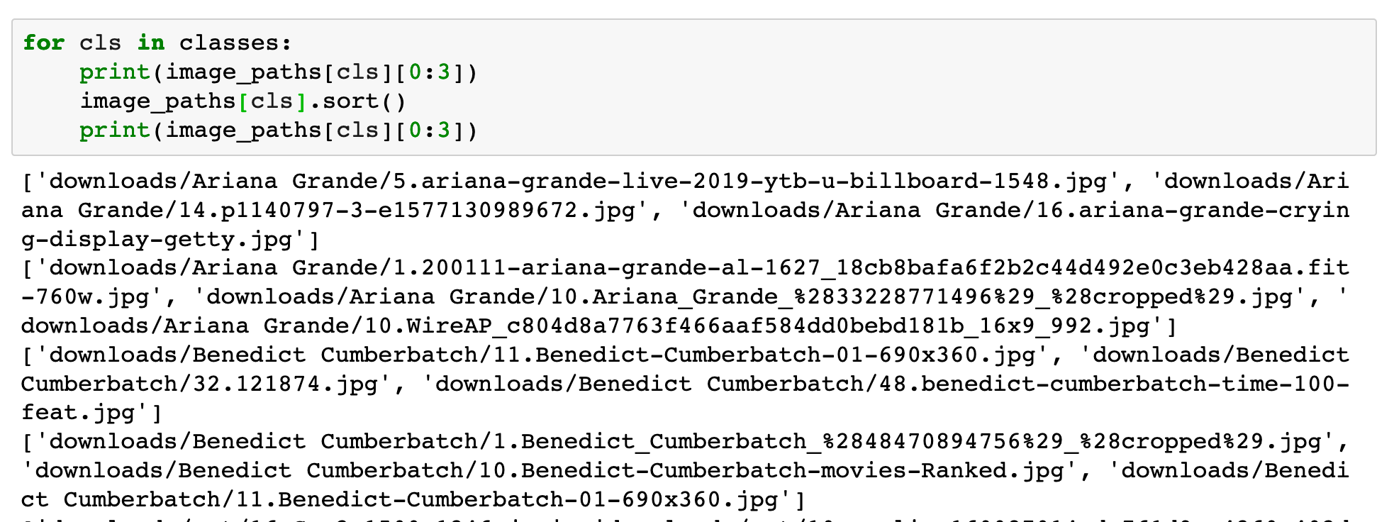

Slide 15
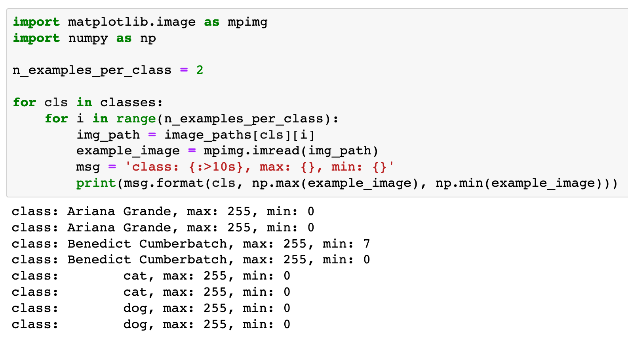

Slide 16
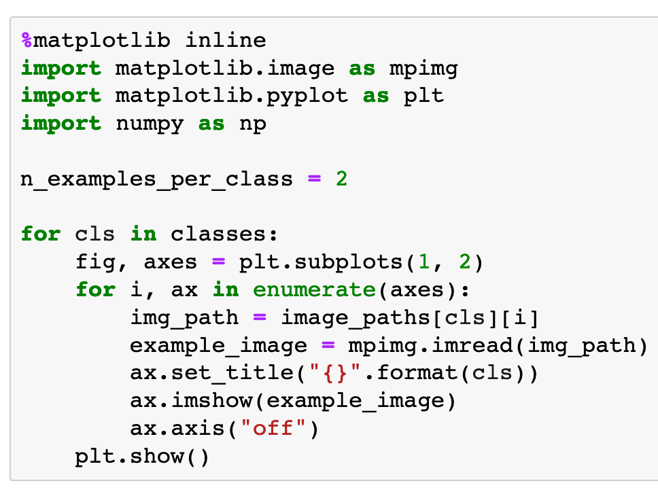

Slide 17
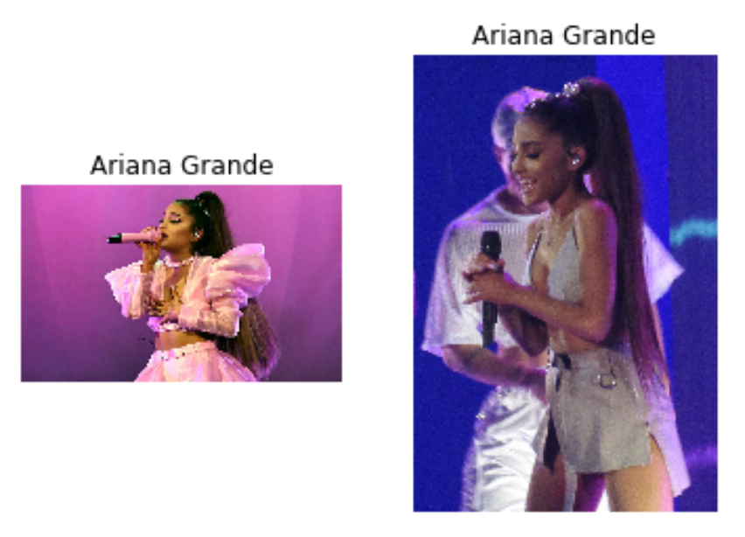

Slide 18
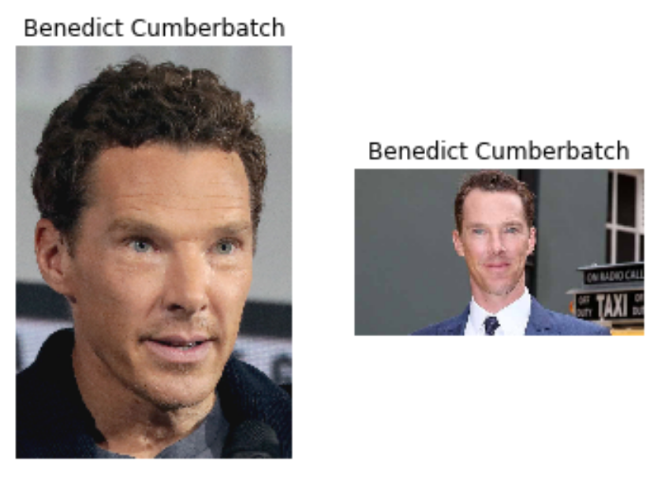

Slide 19
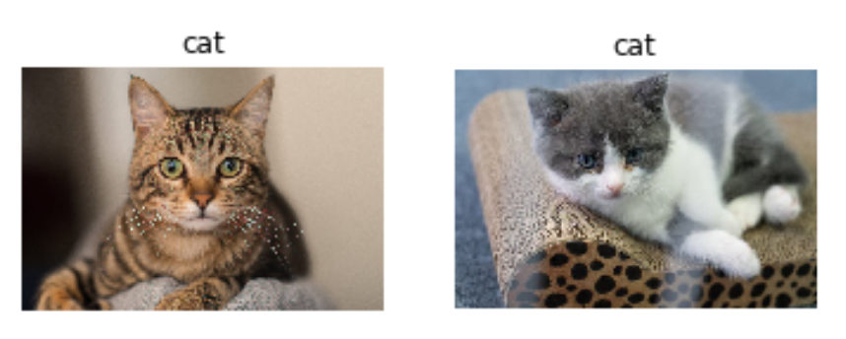

Slide 20
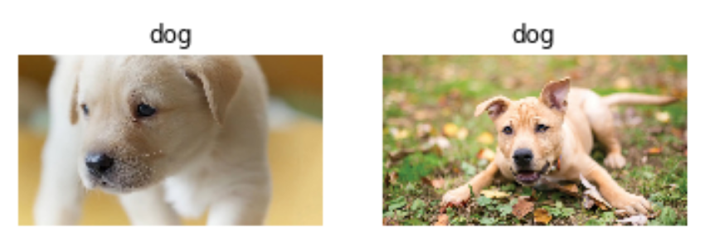

Slide 21
Now
Let’s Play with Code

